Slide 1


Cesar Calderon
10/30/2023

Slide 2

Outline
Executive Summary
Introduction
Methodology
Results
Conclusion
Appendix

Slide 3
Executive Summary
In this project, we will predict if the Space X Falcon 9 first stage will land successfully using several machine learning classification algorithms.
The main steps in this projects are:
Data collection, wrangling and formatting
EDA
Interactive Data Visualization
ML Prediction
Some conclusions are:
Some features of the launches have a correlation with the success or failure to land
Practically all algorithms for prediction give the same result

Slide 4
Introduction
Background: SpaceX, a rocket company, launches satellites at lower prices than their competitor since they has developed a technology to land the first stage booster, which is 70% the cost of the rocket. By landing it safely, they can reuse the booster.
Problem: can we use the previous data of launches of Falcon 9 rocket to predict the probability of the booster landing back to the pad safely?

Slide 5

Section 1

Slide 6
Methodology
Executive Summary
Data collection methodology:
Space X API and Web Scrapping
Perform data wrangling
Pandas, Numpy and SQL
Perform exploratory data analysis (EDA) using visualization and SQL
Perform interactive visual analytics using Folium and Plotly Dash
Perform predictive analysis using classification models
Using Logistic Regression, SVM, Decision Tree and KNN

Slide 7
Data Collection
Data collection is the process of gathering data from available sources. This data can be structured, unstructured or semi-structured. For this project, data was collected via SpaceX API and Web Scrapping from wiki pages for relevant launch data.
SpaceX API: using the REST API, we extract the data in form oof JSON and transform it to a dataframe using inbuilt python pandas methods.
Web Scrapping: web scrapping Space X launches from Wikipedia and converting into a pandas dataframe.

Slide 8
Data Collection – SpaceX API
The API used is https://api.spacexdata.com/v4/rockets/
The API provides data about many types of rocket launches done by Space X, the data is therefore filtered to include only Falcon 9 launches
Every missing value in the data is replaced by the mean of the respective column
We end up with 90 instances and 17 features.
GitHub page here
API Request and read response to DF
Declare global variables
Call helper functions with API calls to populate global variables
Construct data using dictionary
Convert dict to dataframe, filter for Falcon 9 launches

Slide 9
Data Collection - Scraping
Perform HTTP GET to request HTML page
The data is scrapped from List of Falcon 9 and Falcon Heavy launches – Wikipedia
The website contains only the data about Falcon 9 launches
We end up with 121 instances and 11 features
GitHub page here
Create Beautiful Soup object
Extract column names from HTML table header
Create dict with keys from extracted column names
Call helper functions to fill up dict with launch data
Convert dict to dataframe

Slide 10
Data Wrangling
The data is later processed so that there are no missing entries
An extra column called ‘Class’ is also added to the data frame. This column contains 0 if a given launch failed and 1 if it is successful.
GitHub page here

Slide 11
EDA with Data Visualization
The following charts were plotted to gain further insights:
Scatter Plot: it shows the correlation between two variables. The following charts were visualized:
Flight Number and Launch Site
Payload Mass and Launch Site
Flight Number and Orbit Type
Payload Mass and Orbit Type
Bar Chart: it compares values for different categories, making it easy to see which groups are highest/common. Length of each bar is proportional to the value of the items that it represents. The following charts were visualized:
Success Rate and Orbit Type
Line Chart: it depicts trends over time. The following chart was visualized:
Average launch success yearly trend
GitHub page here

Slide 12
EDA with SQL
The data is queried using SQL to answer several questions about data:
Display the names of the unique launch sites in the space mission.
Display 5 records where launch sites begin with the string 'CCA’.
Display the total payload mass carried by boosters launched by NASA (CRS).
Display average payload mass carried by booster version F9 v1.1.
List the date when the first succesful landing outcome in ground pad was achieved.
List the names of the boosters which have success in drone ship and have payload mass greater than 4000 but less than 6000.
List the total number of successful and failure mission outcomes.
List the names of the booster_versions which have carried the maximum payload mass. Use a subquery.
List the records which will display the month names, failure landing_outcomes in drone ship ,booster versions, launch_site for the months in year 2015.
Rank the count of landing outcomes (such as Failure (drone ship) or Success (ground pad)) between the date 2010-06-04 and 2017-03-20, in descending order.
GitHub page here

Slide 13
Build an Interactive Map with Folium
Folium map helps to analyze geospatial data to perform more interactive visual analytics and better understand factors such location and proximity of launch sites that impact landing success rate
Building the Interactive Map with Folium helped answering the following questions:
Are launch sites in close proximity to railways? YES
Are launch sites in close proximity to highways? YES
Are launch sites in close proximity to coastline? YES
Do launch sites keep certain distance away from cities? YES
GitHub page here

Slide 14
Build a Dashboard with Plotly Dash
Plotly Dash web application assists in the interactive visual analytics on SpaceX launch data in real-time. Added launch site dropdown, pie chart, payload range slide and a scatter chart to the Dashboard.
This dashboard helped answering the following questions:
Which site has the largest successful landing? KSC LC-39A (10 successful landings)
Which site has the highest landing successful rate? KSC LC-39A (76.9% success)
Which payload range has the highest lading success rate? 2000-5000 kg
Which payload range has the lowest landing success rate? 0-2000 and 5500-7000 kg
Which F9 booster version has the highest landing success rate? FT
GitHub page here

Slide 15
Predictive Analysis (Classification)
Read dataset into dataframe and create ‘class’array
Functions from sklearn library are used to create our machine learning models
The following machine learning algorithms were tested:
Logistic Regression
SVM
Decision Tree
K Nearest Neighbors (KNN)
The best selected model are chosen based on their accuracy score on test data and confusion matrix
GitHub page here
Standardize the data
Train/test split data
Create and refine models
Find the best performing model

Slide 16

Section 2

Slide 17
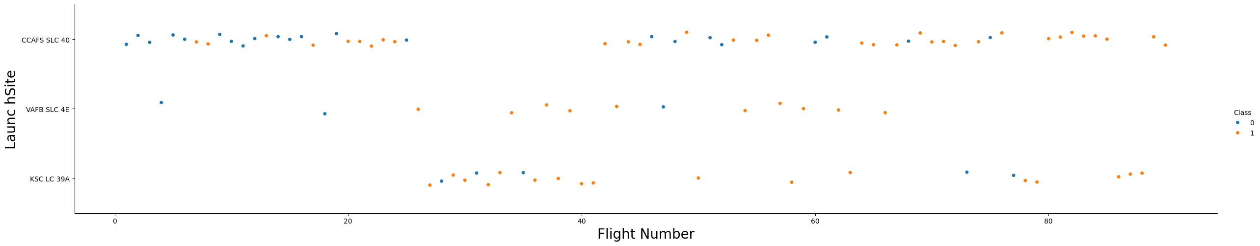
Flight Number vs. Launch Site
Success rate (class 1) increases as the number of flights increases
For launch site KSC LC 39Am it takes at least 25 launches before a first successful launch

Slide 18
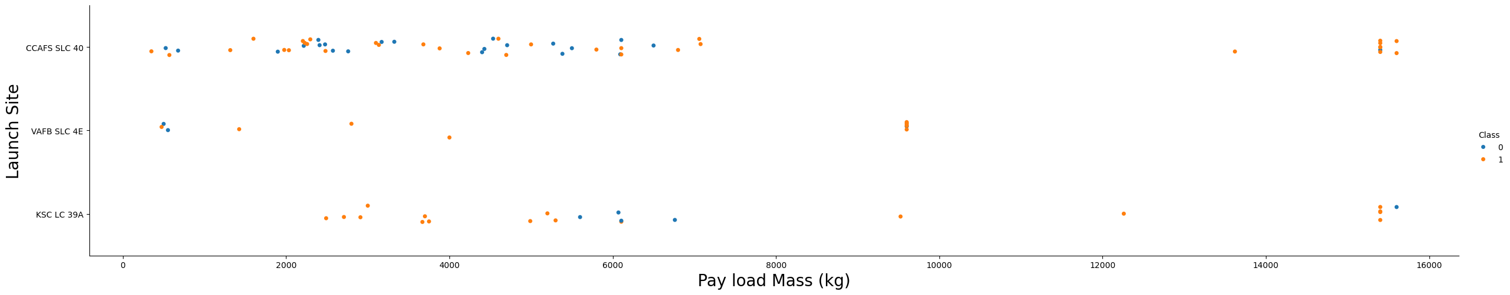
Payload vs. Launch Site
For launch site VAFB SLC 4E:
There are no rockets launched with payload mass greater than 10,000 kg
Rate of successful landing (class 1) increases with payload mass
There are no clear correlation between launch site and payload mass

Slide 19
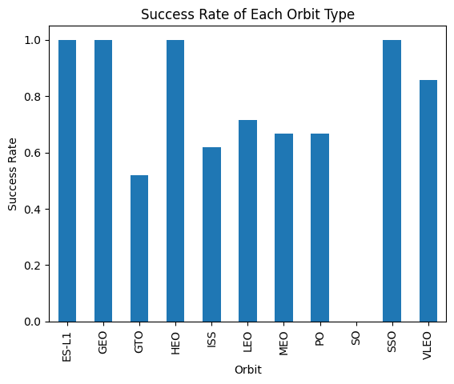
Success Rate vs. Orbit Type
Orbits ES-L1, GEO, HEO and SSO have the highest successful rates
GTO orbit has the lowest success rate

Slide 20
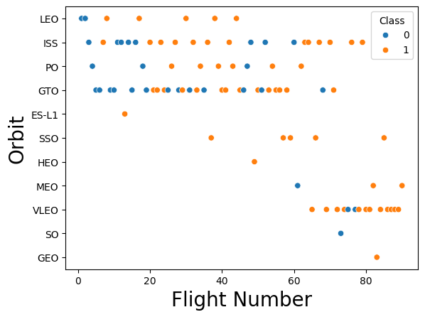
Flight Number vs. Orbit Type
For VLEO, first successful landing (class 1) doesn’t occur until 60+ number of flights
For most orbits (LEO, ISS, PO, SSO, MEO, VLEO) successful landing rates appear to increase with flight numbers
There is no correlation between flight number and orbit for GTO

Slide 21
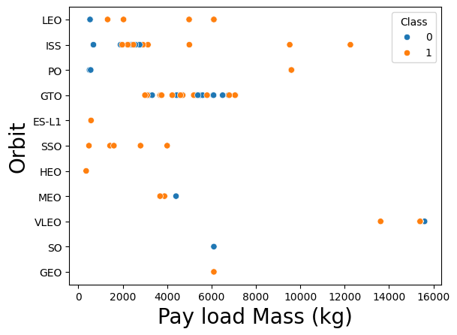
Payload vs. Orbit Type
Successful landing rates (class 1) appear to increase with Pay load mass for orbits LEO, ISS, PO, SSO
For GEO orbit, there is no correlation between payload mass and orbit for a successful landing

Slide 22
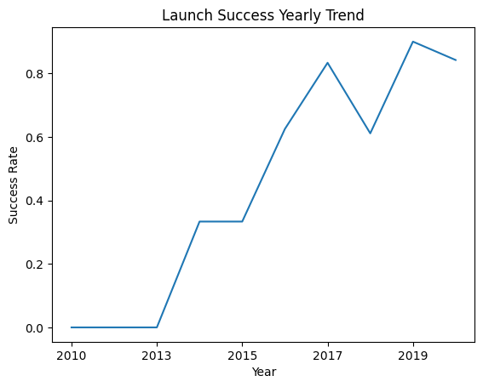
Launch Success Yearly Trend
Success rates increased about 80% between 2013 and 2020
Success rates remained the same between 2010 and 2013 and between 2014 and 2015
Success rates decreased between 2017and 2018 and between 2019 and 2020

Slide 23
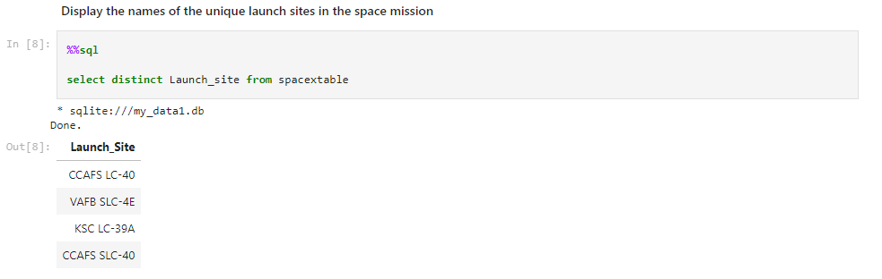
All Launch Site Names
‘distinct’ returns only the unique values from the queries column
There are four unique launch sites

Slide 24
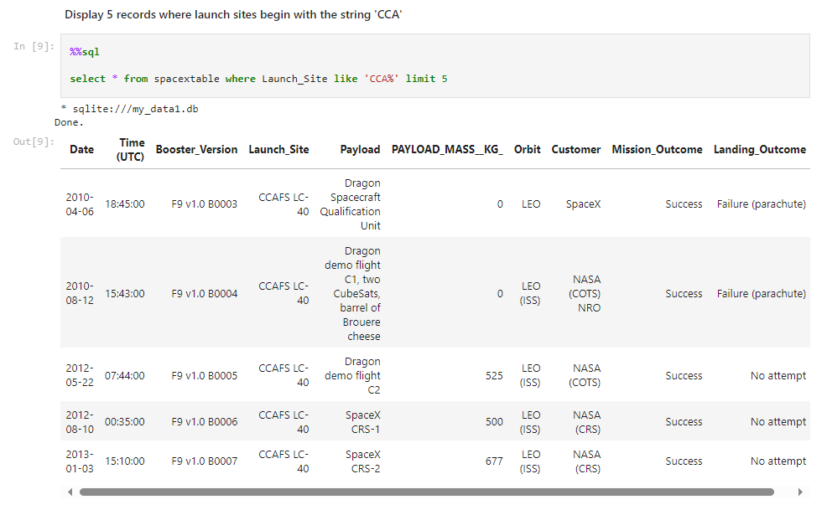
Launch Site Names Begin with 'CCA'
using ‘like’ and format ‘CCA%’, it returns records where Launch_Site column starts with ‘CCA’
‘limit 5’ limits the number of returned records to 5

Slide 25
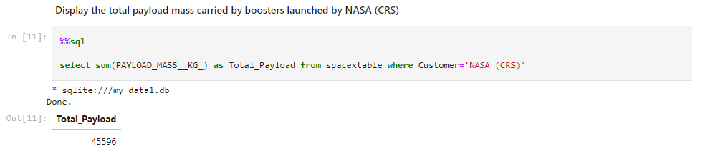
Total Payload Mass
‘sum’ adds column ‘Payload_mass__kg_’ and returns total payload mass for customers named ‘NASA (CRS)’

Slide 26
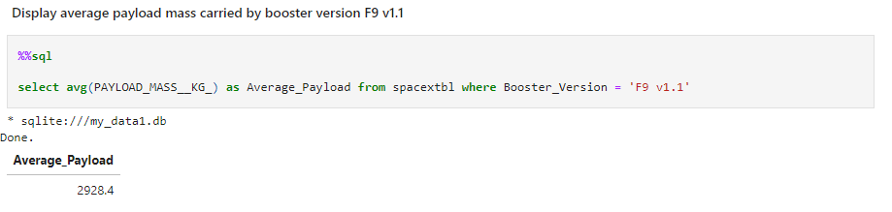
Average Payload Mass by F9 v1.1
‘avg’ returns the average of payload mass in ‘PAYLOAD_MASS__KG_’ column where booster version is ‘F9 v1.1’

Slide 27
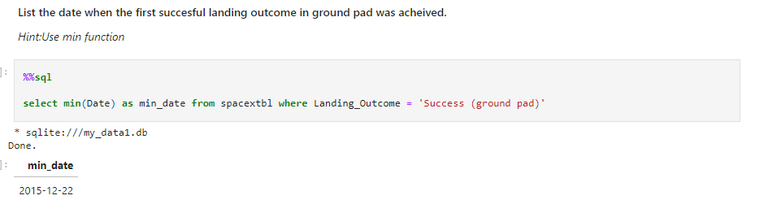
First Successful Ground Landing Date
‘min(Date)’ selects the first or the oldest date from ‘Date’column where first successful landing on group pad was achieved

Slide 28
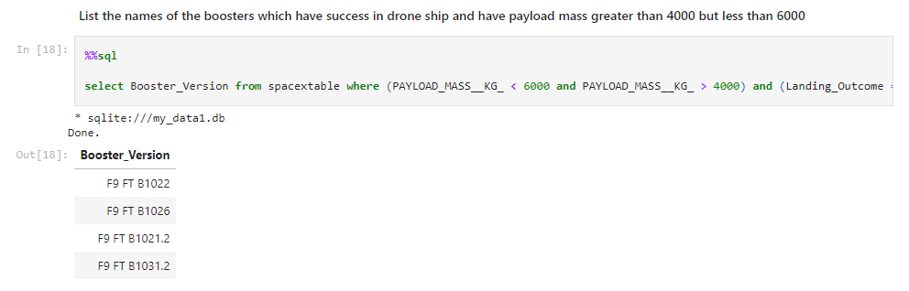
Successful Drone Ship Landing with Payload between 4000 and 6000
the query finds the booster version where payload mass is greater than 400 but less than 6000 and the landing outcome is successful in drone ship
the ‘and’ in the ‘where’ clause returns booster version where both conditions are true

Slide 29
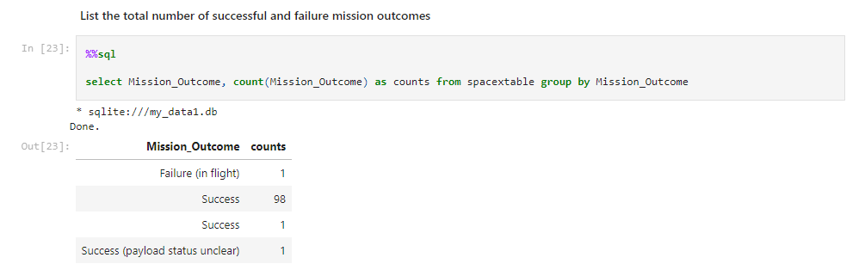
Total Number of Successful and Failure Mission Outcomes
the ‘group by’ arranges identical data in a column in to groups

Slide 30
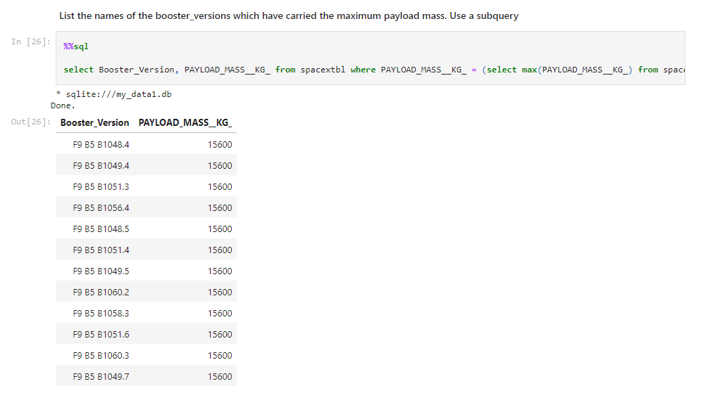
Boosters Carried Maximum Payload
the subquery returns the maximum payload mass by using ‘max’
the main query returns booster version and respective payload mass where the last is maximum with value of 15600

Slide 31
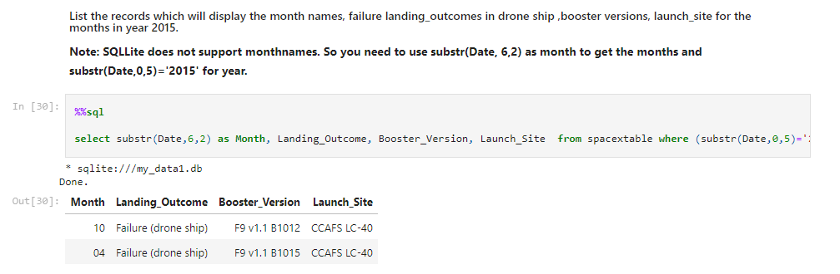
2015 Launch Records
the result identify launch sites as ‘CCAFS LC-40’ and booster version as ‘F9 v1.1 B1012’ and ‘F9 v1.1 B1015’ that had failed landing in drop ship in the year 2015.

Slide 32
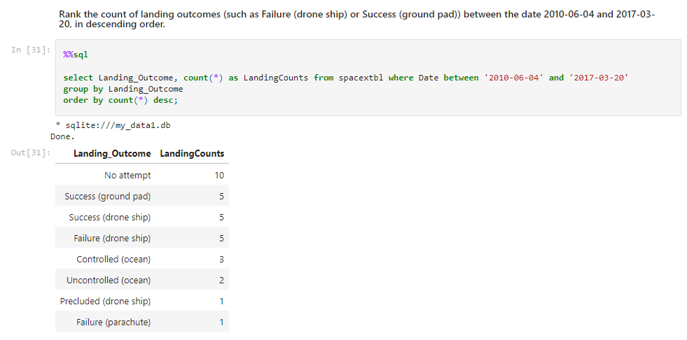
Rank Landing Outcomes Between 2010-06-04 and 2017-03-20
the ‘order by’ arranges the counts in descending order

Slide 33

Section 3

Slide 34
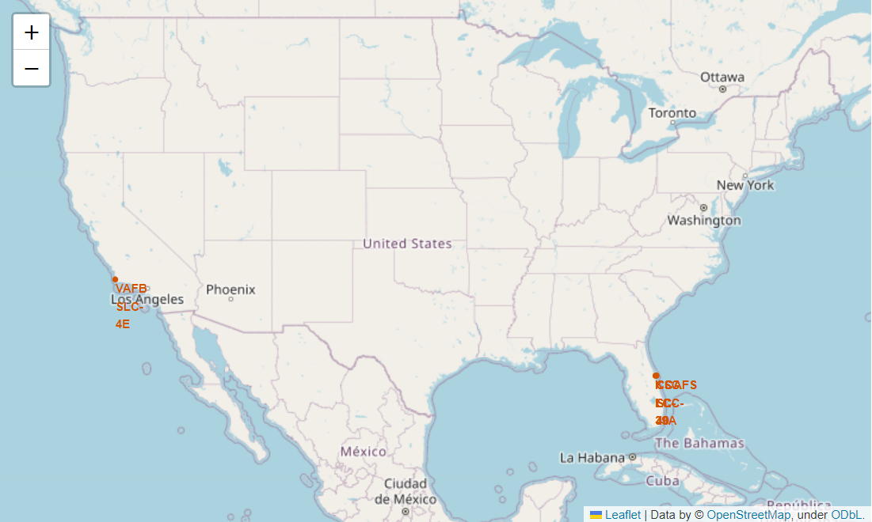
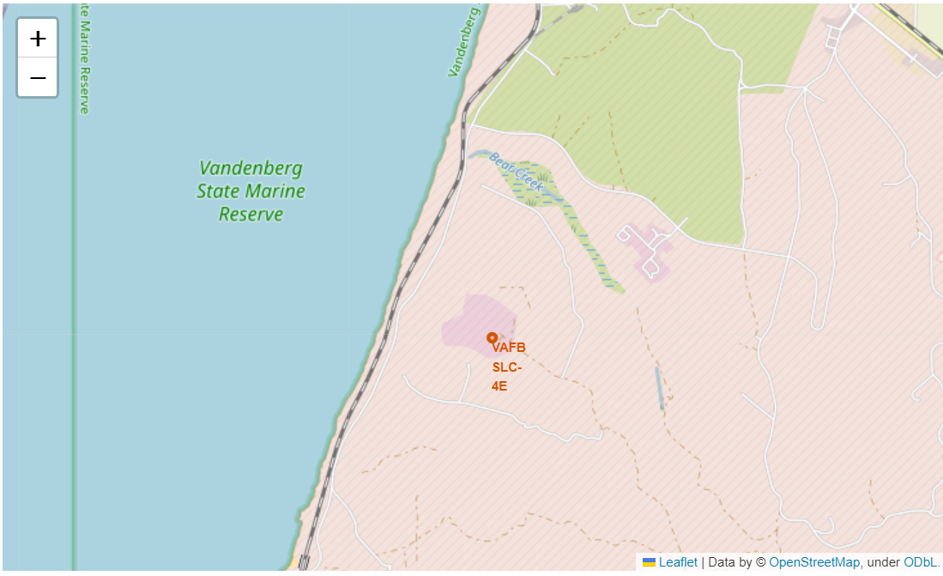
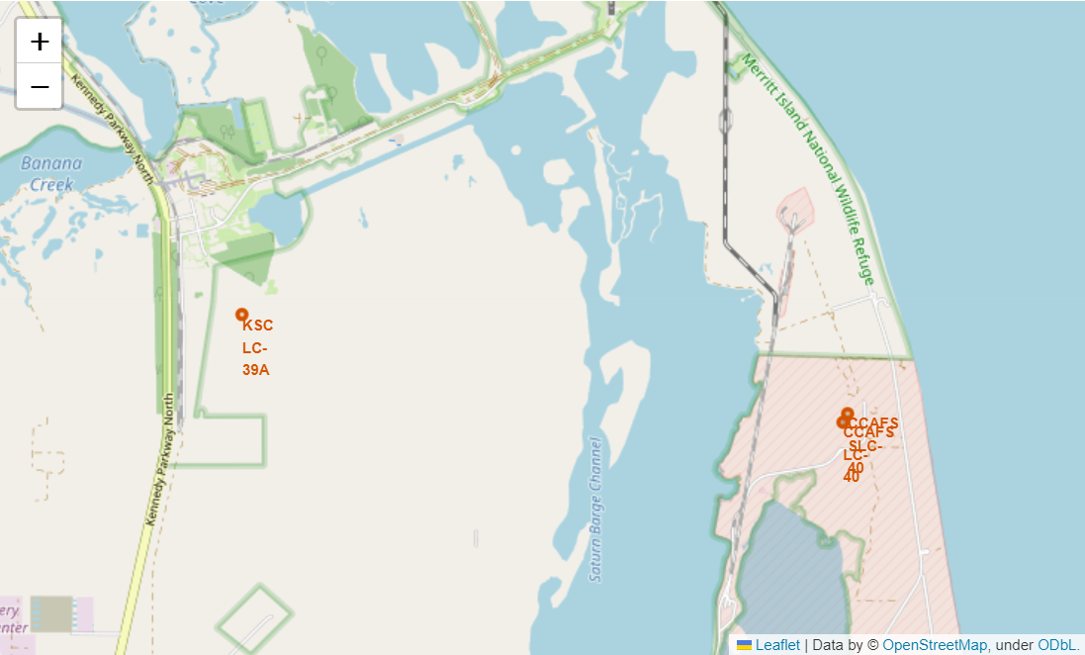
SpaceX Falcon9 – Launch Sites Map
Figure 1 on the eft displays the global map with Falcon 9 lauch sites are located in the USA (California and Florida). Each launch site contains a circle, a label and a popup to highlight the location and the name of the launch site. It is also evident that all launch sites are near the coastline.
Figure 1 – Global Map
Figure 2 – Zoom 1
Figure 3 – Zoom 2

Slide 35
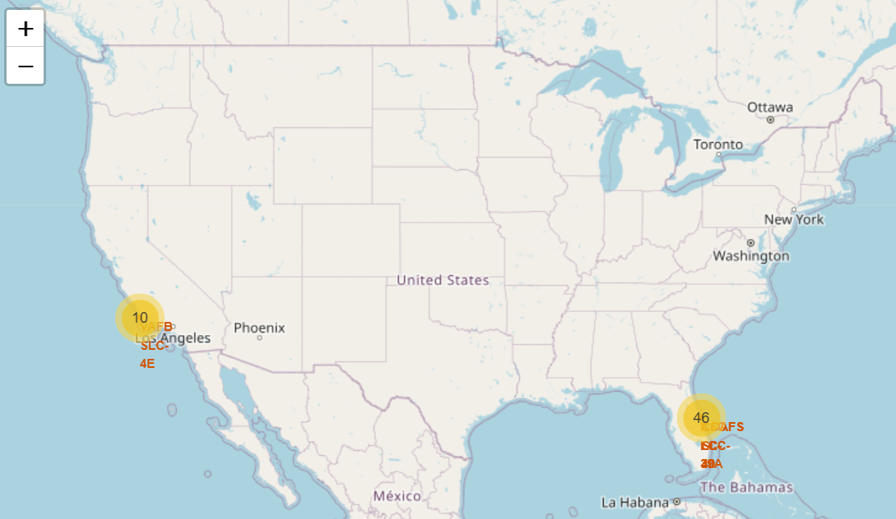
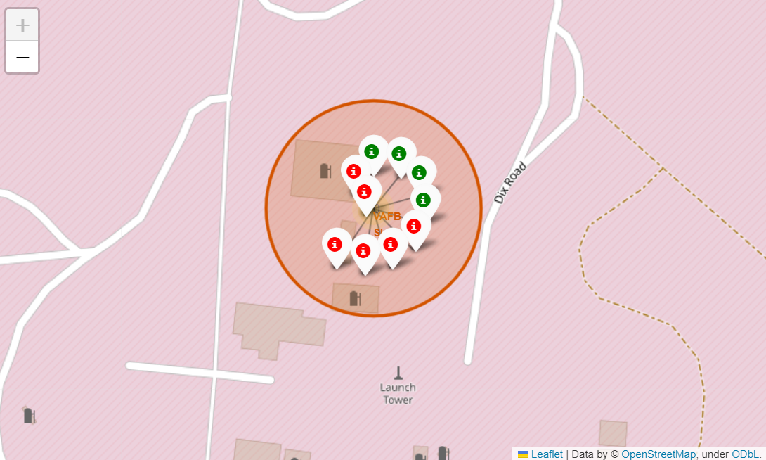
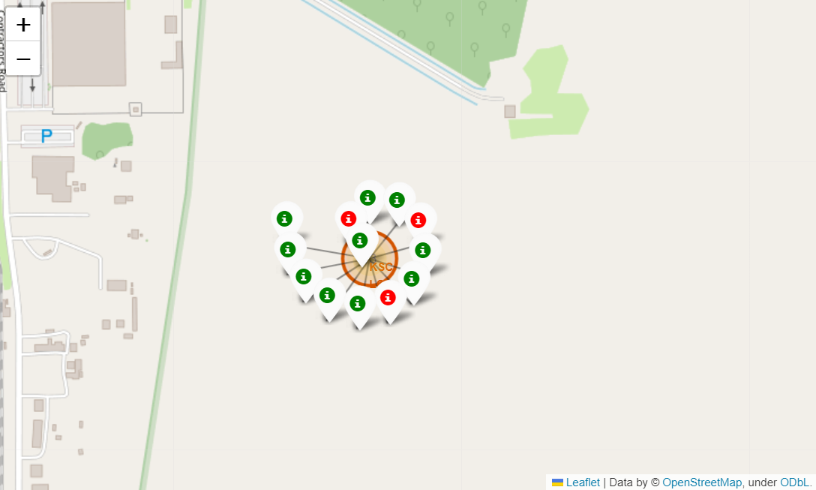
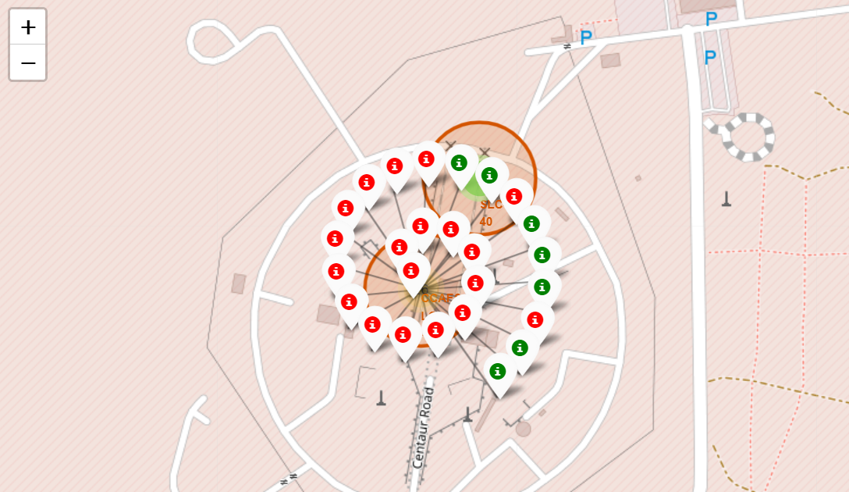
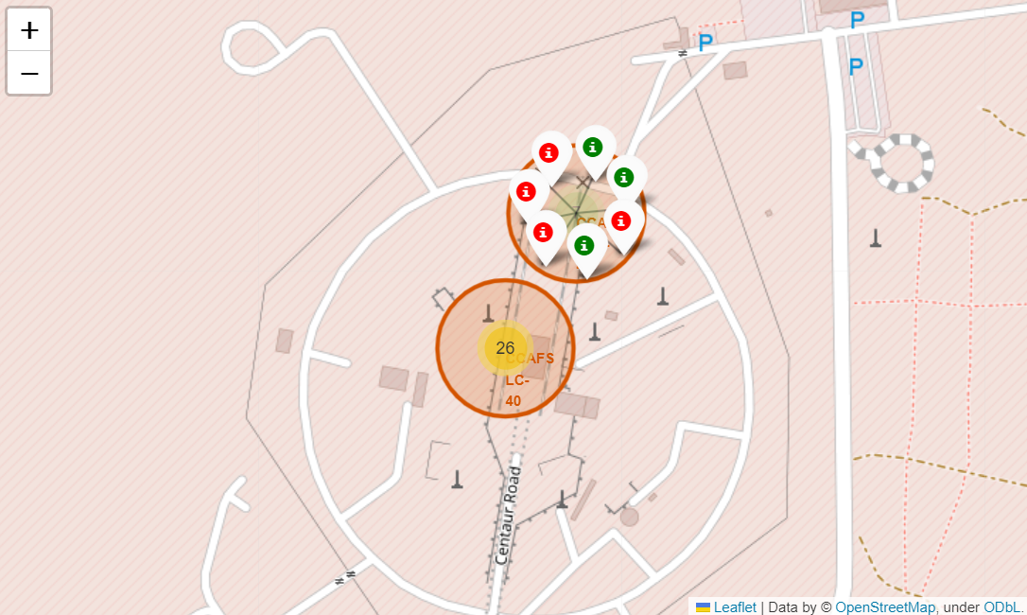
SpaceX Falcon 9 – Success/Fail Launch Map
Figure 1 is the US map with all the launch sites. The numbers on each site depicts the total number of launches.
Figure 2, 3, 4 and 5 zoom in each site and displays the success (green) and fail (red) markers.
By looking at eah site map, KSC LC-39A has the greatest number of successful landings.
Figure 1 – US map with all launch sites
Figure 2 – VAFB Launch Site with
success/fail markers
Figure 3 – KSC LC-39A Launch Site with
success/fail markers
Figure 4 – CCAFS LC-40 Launch Site with
success/fail markers
Figure 5 – CCAFS SLC-40 Launch Site with
success/fail markers

Slide 36
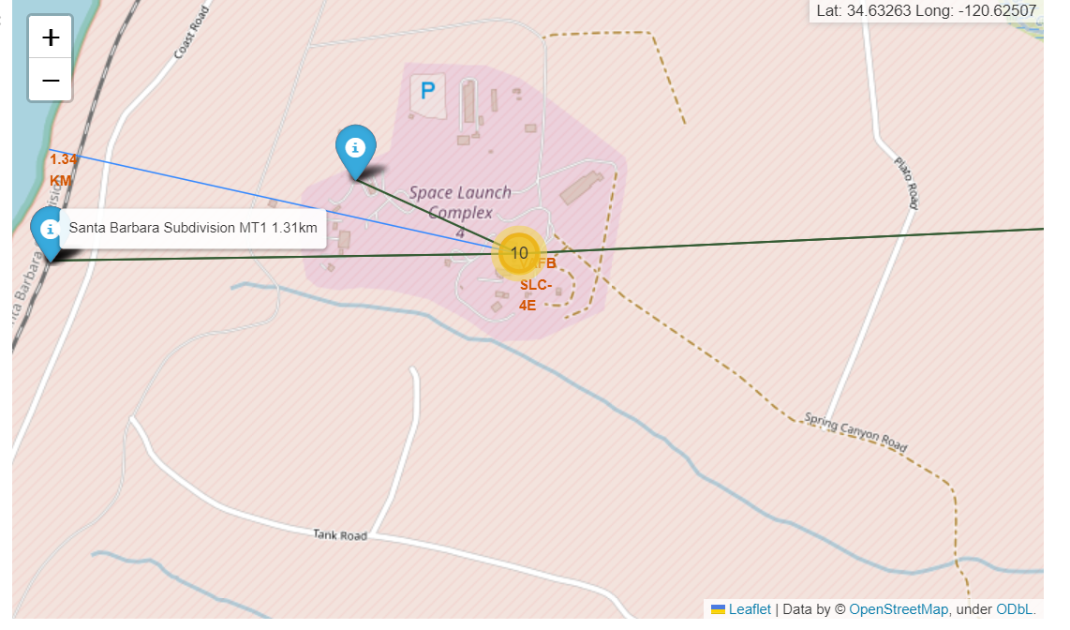
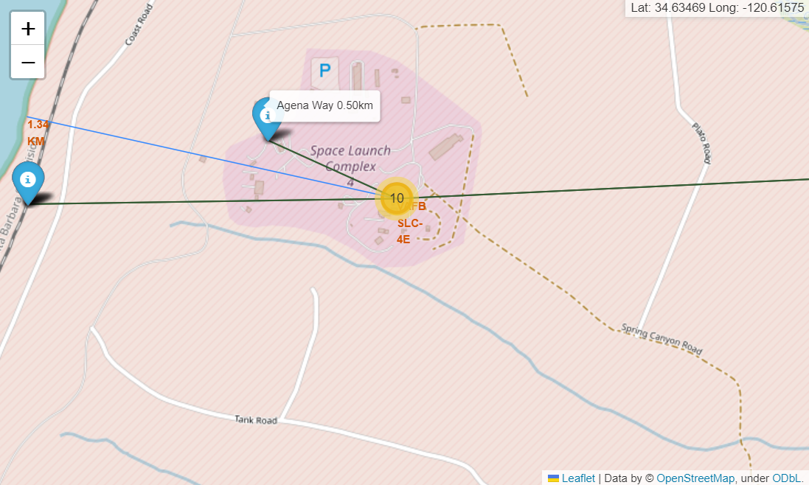
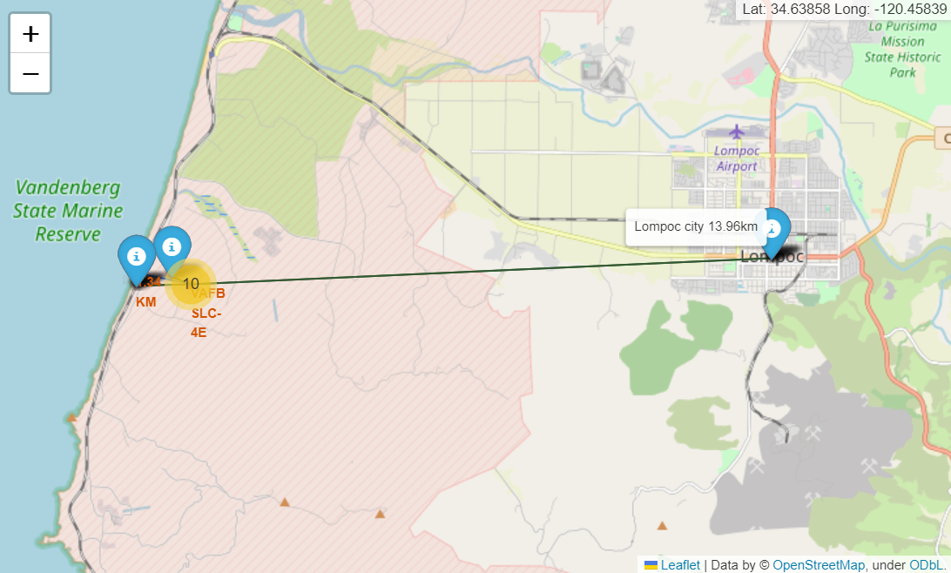
SpaceX Falcon9 – Launch Site Distance Map
Figure 1 – Proximity site map for VAFB SLC-4E for different sites
In general, cities are located further away from the launch site to minimize impacts of any accident to the public and infrastructure. Launch sites are strategically located near coastline, railroad and highways to provide easy access to resources.

Slide 37

Section 4

Slide 38
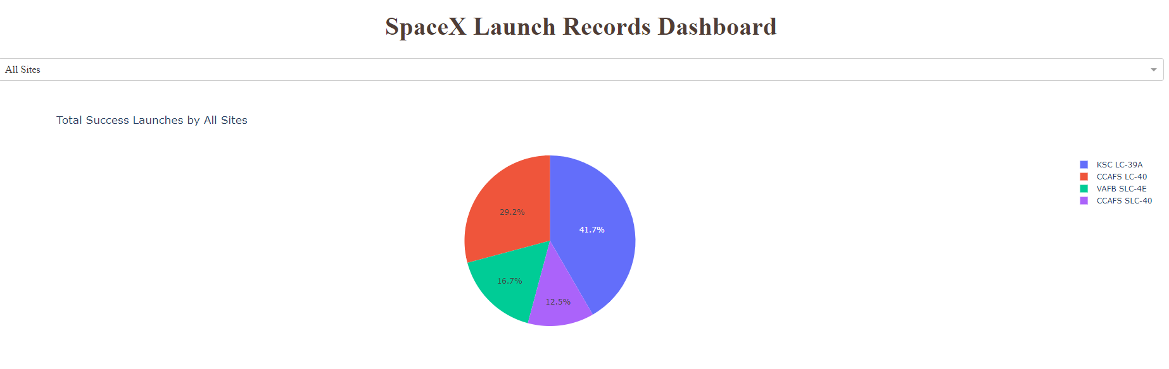
Launch Success Counts for all sites
Launch site KSC LC-39A has the highest launch success rate.
Launch site CCAFS SLC-40 has the lowest launch success rate.

Slide 39
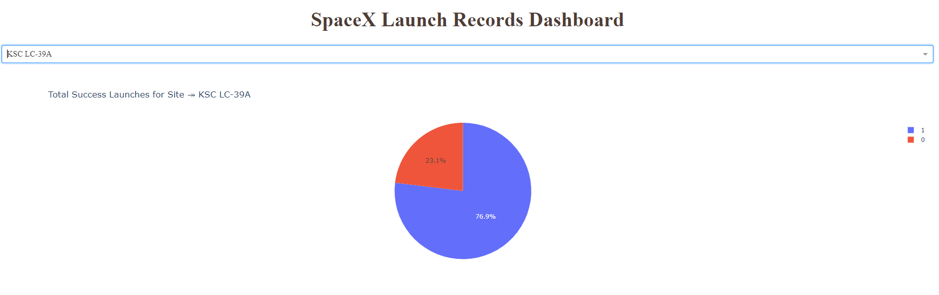
Launch Site with Highest Launch Success Ratio
Launch success rate is 76.9%
Launch failure rate is 23.1%

Slide 40
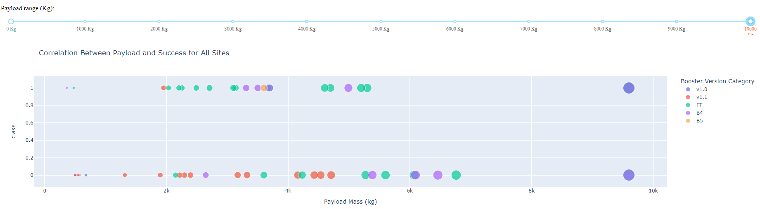
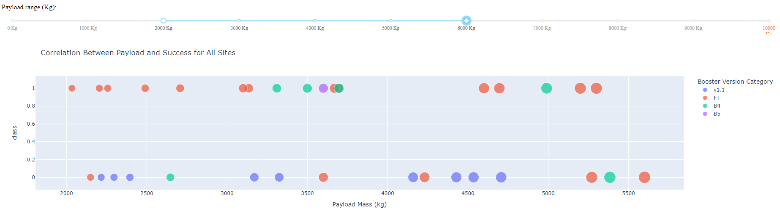
Payload vs. Launch Outcome Scatter Plot for all sites
Most successful launches are in the payload range from 2000 to about 5500 kg
Booster version category “FT” has the most successful launches
Only booster with a successful launch when payload is greater than 6000 kg is B4

Slide 41

Section 5

Slide 42
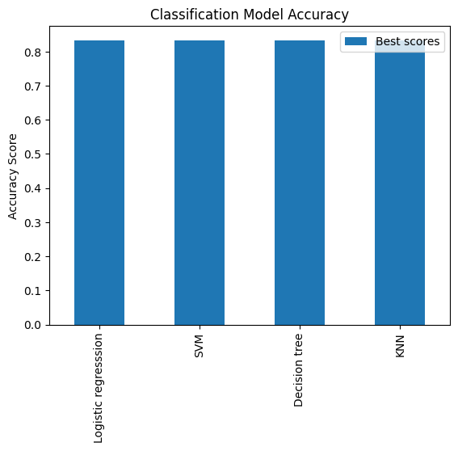
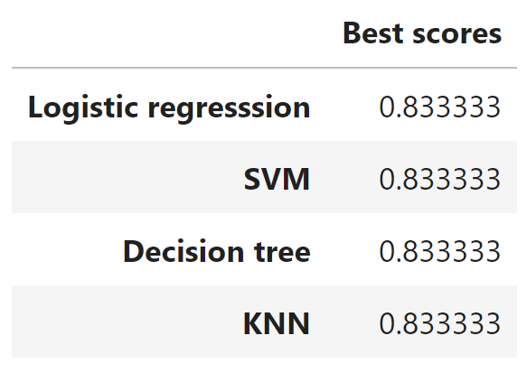
Classification Accuracy
Accuracy score on the test data is the same for all the classification algorithms based on the test set with a value of 0.8333
Given the accuracy scores for classification algorithms are the same, we may need a broader dataset to further tune the models.

Slide 43

Confusion Matrix
The confusion matrix is same for all the models (LR, SVM, Decision Tree, KNN)
Per the confusion matrix, the classifier made 18 predictions
12 scenarios were predicted Yes for landing, and they did land successfully (True positive)
3 scenarios (top left) were predicted No for landing, and they did not land (True negative)
3 scenarios (top right) were predicted Yes for landing, but they did not land successfully (False positive)
Overall, the classifier is correct about 83% of the time ((TP + TN) / Total) with a misclassification or error rate ((FP + FN) / Total) of about 16.5%

Slide 44
Conclusions
As the numbers of flights increase, the first stage is more likely to land successfully
Success rates appear go up as payload increases but there is no clear correlation between payload mass and success rates
Launch success rate increased by about 80% from 2013 to 2020
Launch Site KSC LC-39A has the highest launch success rate and Launch Site CCAFS SLC40 has the lowest launch success rate
Orbits ES-L1, GEO, HEO, and SSO have the highest launch success rates and orbit GTO the lowest
Launch sites are located strategically away from the cities and closer to coastline, railroads, and highways
All the models scored the same on the test data, the accuracy score was about 83% for all models. More data may be needed to further tune the models and find a potential better fit.

Slide 45


